Slide 1

LOVE IS A DATA FIELD
Sharon
Shai
Lara
2022

Slide 2
Dataset
A data set consisting of user profile data for 59,946 OkCupid users (a free online dating website) who were living within 25 miles of San Francisco from a period in the 2010s.
The data set includes typical user information (such as sex, sexual orientation, age, and ethnicity), lifestyle variables (such as diet, drinking habits, smoking habits) and text responses to 10 essays questions.

Slide 3
Essays Questions
“My Self Summary”
“What I’m doing with my life”
“I’m really good at”
“The first thing people usually notice about me”
“Favorite books, movies, show, music, and food”
“The six things I could never do without”
“I spend a lot of time thinking about”
“On a typical Friday night I am”
“The most private thing I am willing to admit”
“You should message me if…”

Slide 4
What does the San Francisco online dating landscape look like?
Demanding work schedules, long commutes, San Francisco men who suffer from Peter Pan syndrome (guys who don’t approach women offline),and shortage of women are some of the most commonly referenced reasons for such frustration among single folks in San Francisco.

Slide 5

Formatting and Cleaning Data
Convert height to meters, split city and state, take only the religion name
Find missing values
Height Analysis

Slide 6
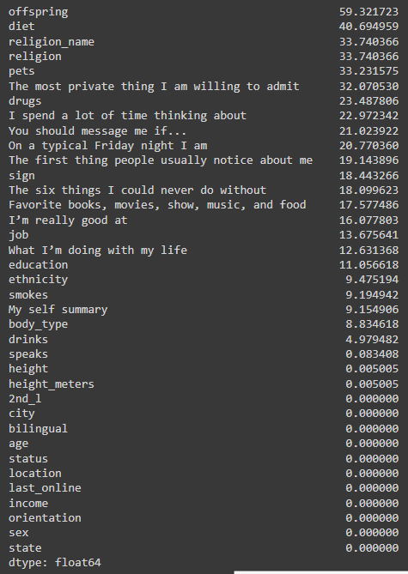
Find missing values

Slide 7
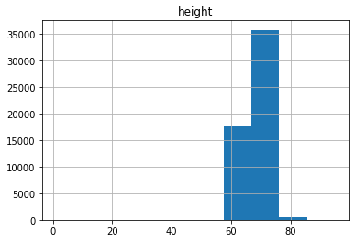
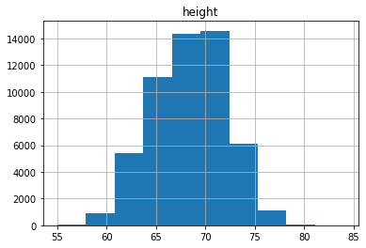
Height Analysis

Slide 8

Business Questions and Analysis

Slide 9
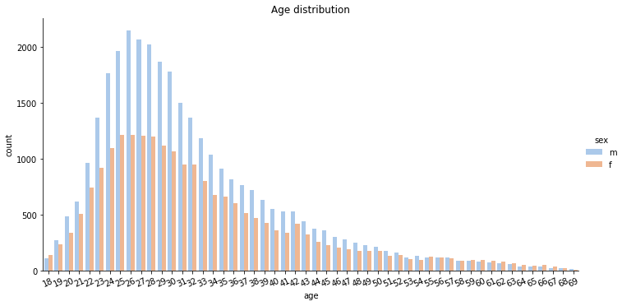

Age , sex and orientation
Hii SSL, we are a hip new night club for singles, can you please tell us about our target audience?
Most of the single male and female are between 24-30
you can see that the older they get its more even between the sexes
We also build HTML so the night club can go into more details about the target audience

Slide 10
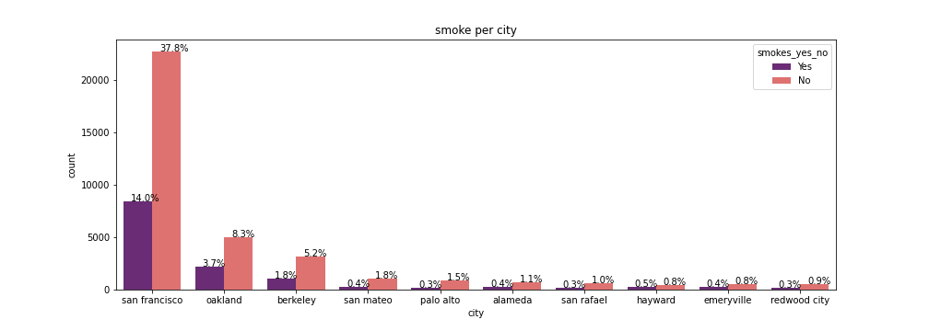
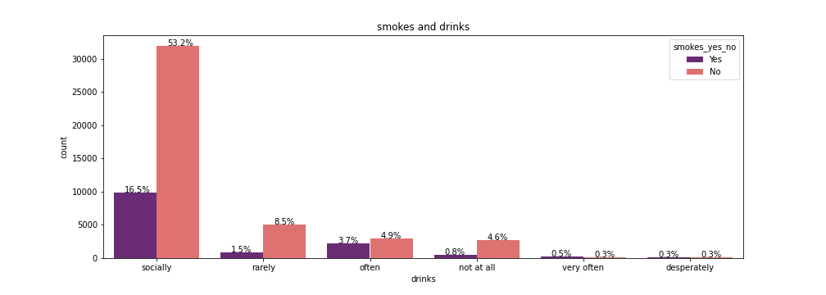
Smokes
Hello , We are the non-profit Smokes-Kills.
We are doing a new anti-smoke campaign an want to know where to put the ads and the target audience

Slide 11
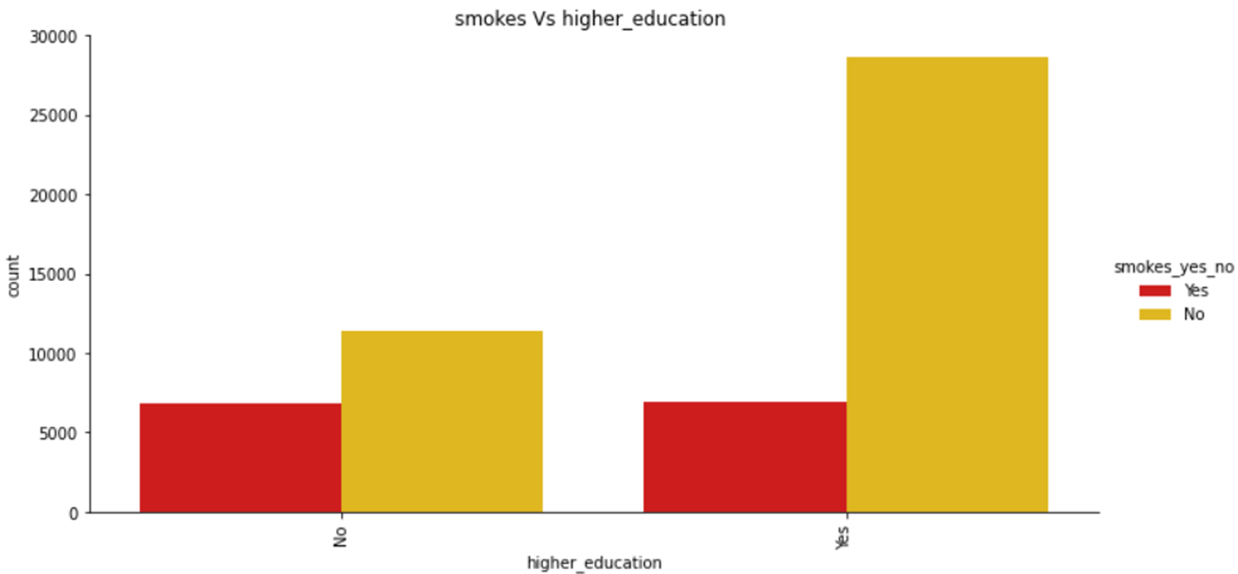
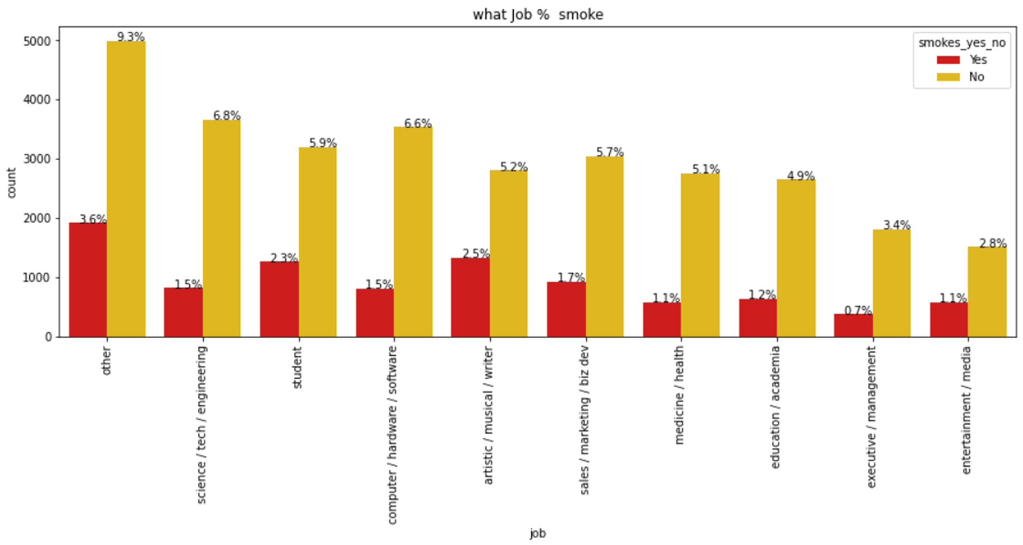
Smokes
From the plots you can see that SF have the most smokers and you should put the ad outside an artist Pub in blue color neighborhood

Slide 12
Text Analysis

Slide 13
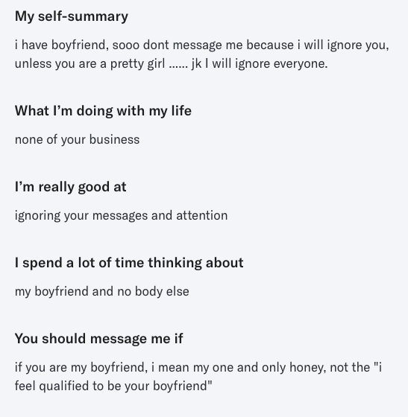

Text Analysis
10 introductory questions
unified text column
Profile users
Find Patterns
Find potential Matches
What do women want

Slide 14
Effectively Pre-processing the Text Data: Text Cleaning
De-capitalization
Removing Unwanted Characters: numbers, emojis, punctuation, spaces
Removing Stopwords
Rare words removal
Lemmatization

Slide 15
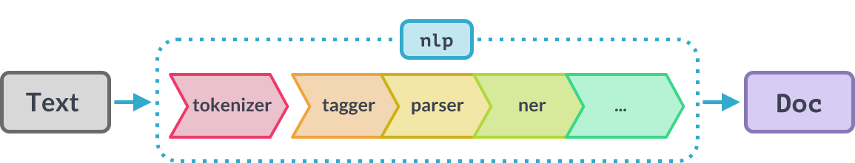
spaCy’s Processing Pipeline
Notes:
When you call nlp on a text, spaCy first tokenizes the text to produce a Doc object.
The Doc is then processed in several different steps – this is also referred to as the processing pipeline.
The pipeline used by the trained pipelines typically include a tagger, a lemmatizer, a parser and an entity recognizer.
Each pipeline component returns the processed Doc, which is then passed on to the next component.
The capabilities of a processing pipeline always depend on the components, their models and how they were trained.
For example, a pipeline for named entity recognition needs to include a trained named entity recognizer component with a statistical model and weights that enable it to make predictions of entity labels.

Slide 16
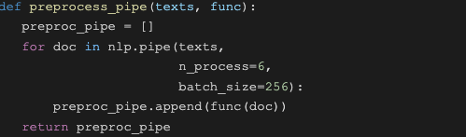
Processing Text
When processing large volumes of text, the statistical models are usually more efficient if you let them work on batches of texts.
spaCy’s nlp.pipe method takes an iterable of texts and yields processed Doc objects.
It process the texts as a stream and buffer them in batches, instead of one-by-one.
(Also, Multiprocessing.)
Notes:
We used the large trained model for the english language, en_core_web_lg which includes trained pipelines & weights.
Set up an nlp object.
Create a doc object that is the processed version of the string input = a container of tokens.
The tokens in a Doc object are Token objects, with a long list of attributes.
When you call nlp on a text, spaCy will tokenize it and then call each component on the Doc, in order.
It then returns the processed Doc that you can work with.
When processing large volumes of text, the statistical models are usually more efficient if you let them work on batches of texts.
spaCy’s nlp.pipe method takes an iterable of texts and yields processed Doc objects. The batching is done internally.
n_process for multiprocessing.
Process the texts as a stream using nlp.pipe and buffer them in batches, instead of one-by-one.

Slide 17
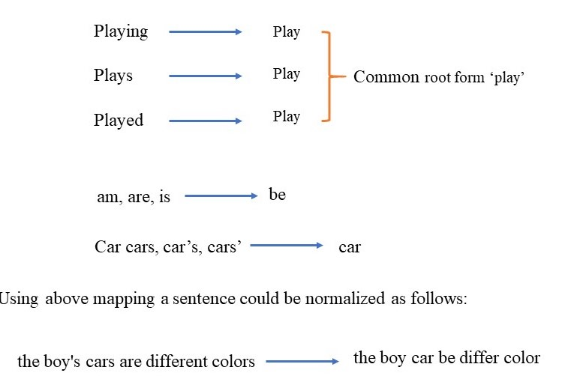
Lemmatization - Using spaCy’s attributes
Notes:
Lemmatization groups together words with the same root or lemma but with different inflections or derivatives of meaning so they can be analyzed as one item.
The aim is to take away inflectional suffixes and prefixes to bring out the word’s dictionary form.
Disclaimer - As the dataset was very large, we had to narrow it down to a sample of 10% of the data points in order for NLP efficient processing.

Slide 18
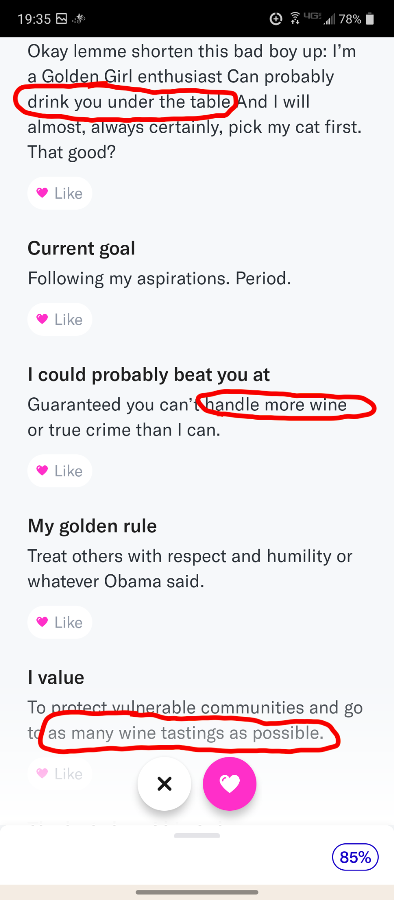
Look for the pattern

Slide 19
Matcher - Rule-Based Matching using spaCy
We can look for a rule-based matching using the token attributes of spaCy’s objects:
pattern = [{"TEXT": "Alice"}, {"POS": "VERB"}]
pattern = [{"POS": "ADJ"}, {"POS": "NOUN"}]
pattern = [{"TEXT": "Alice"}, {"IS_PUNCT": True,"OP":"*"}]
Notes:
We can look for a rule-based matching using the token attributes of spaCy’s objects.
With the spaCy Matcher object, you can find words and phrases in the text using user-defined rules.
spaCy matcher uses the text patterns as well as the lexical properties of the word, such as POS tags, dependency tags, lemma, etc.
We tried to look for more specific patterns in the different answers according to the subject.
Breaking down the raw text into subject keyword can contribute to a more precise analysis of profiling and better matching.

Slide 20
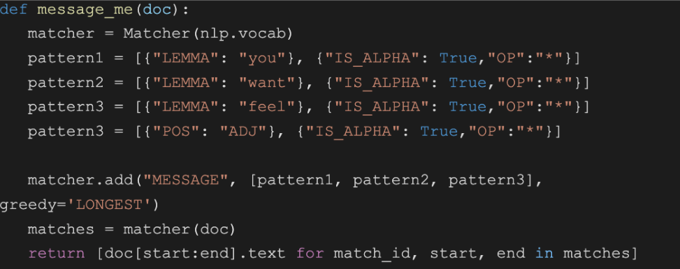
Match Text Patterns & Lexical Properties
spaCy matcher uses the text patterns as well as the lexical properties of the word, such as POS tags, dependency tags, lemma, etc.

Slide 21
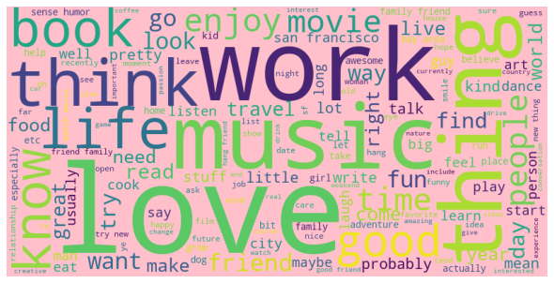
Most frequent words in unified text
WordCloud
Notes:
In a Word Cloud different sizes represent the frequency or the importance of each word.
Also called Tag Cloud.

Slide 22
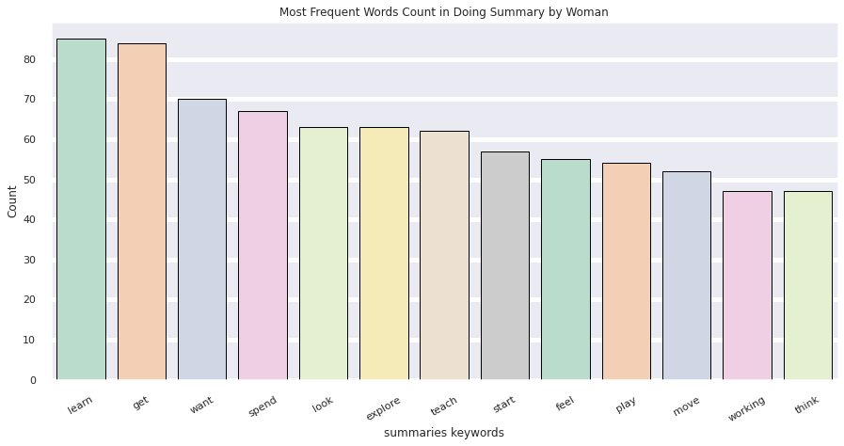
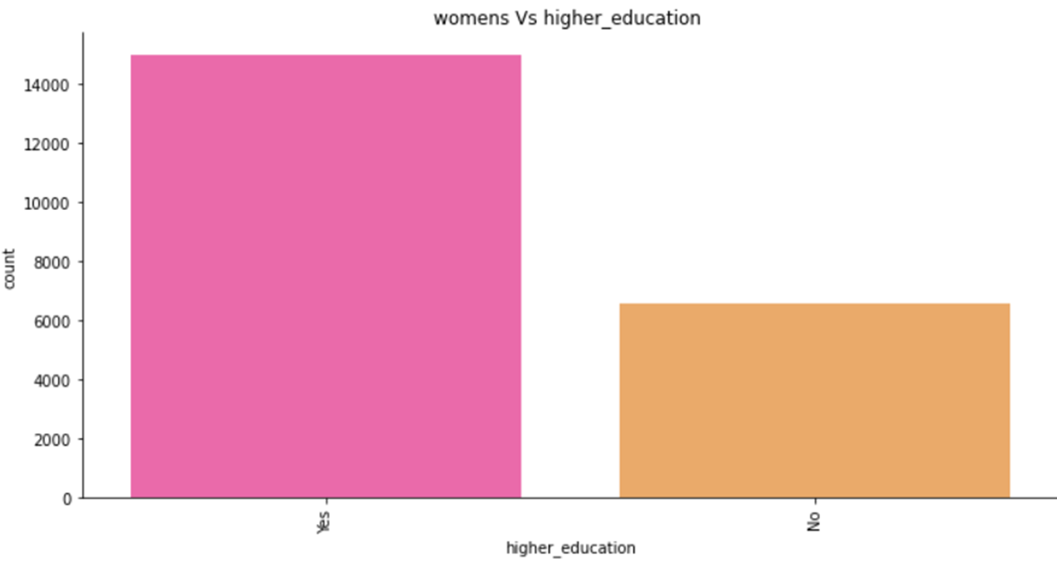
Most Frequent Words Count in Doing Summary by Woman

Slide 23
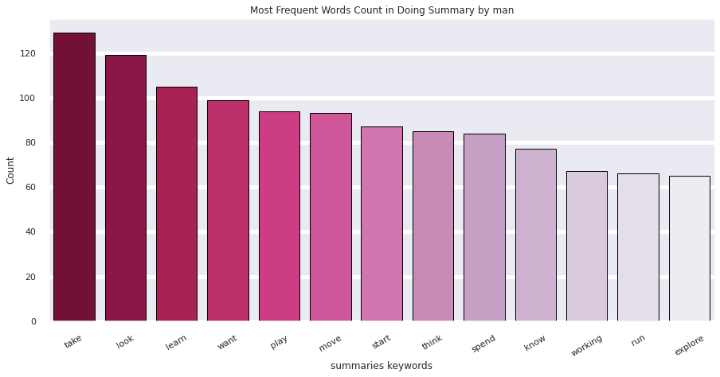
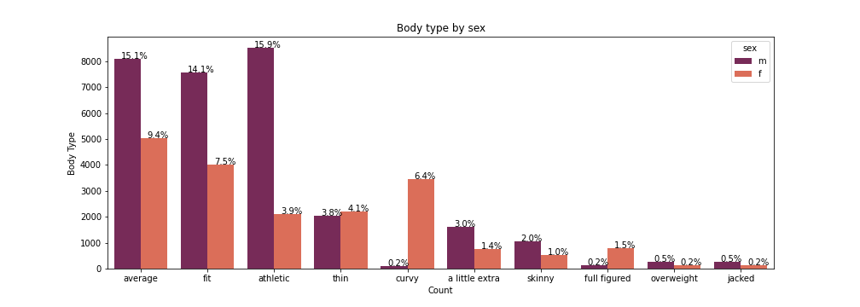
Most Frequent Words Count by man Vs Body type

Slide 24
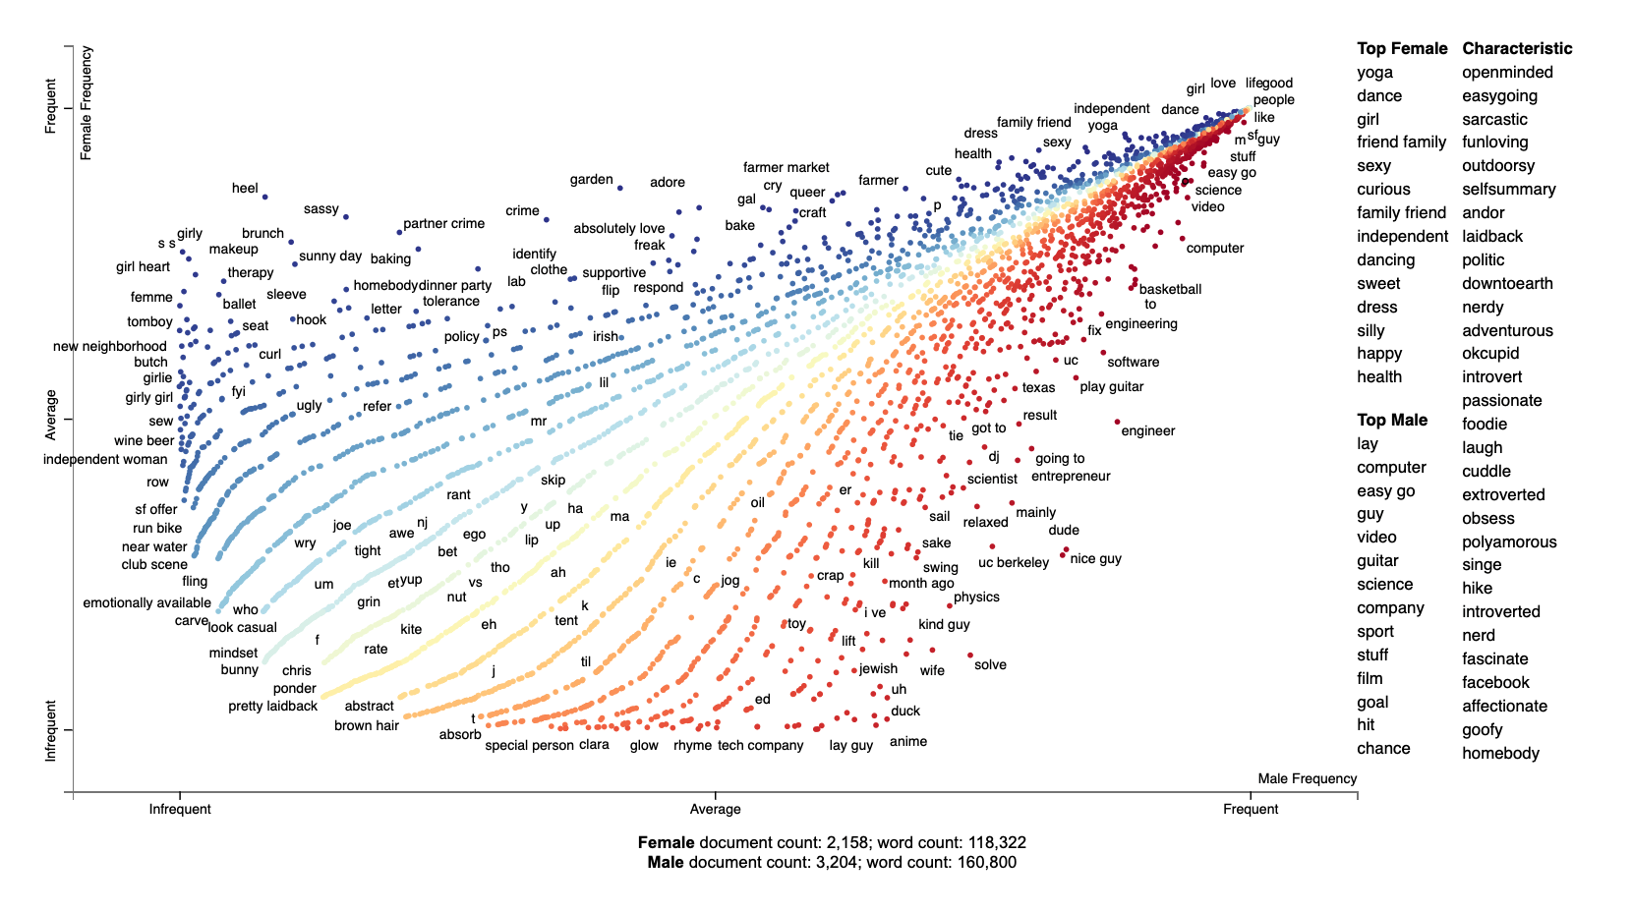

What women & men are saying about themselves:

Slide 25
Frequent words to both sexes (middle line)
Male:
“humble easygoing sarcastic tattooed entrepreneur value honesty humor nice smile ptetty ladyy”
passionate singersongwriter funkyass dancer
nerd like science science fiction anime video game type game comic strip late night tv read internet geeky
Female:
“proudly nerdy sarcastic generally happy person”
welsh woman passionate hard music irish whiske
study computer science grad school work startup company software engineer

Slide 26
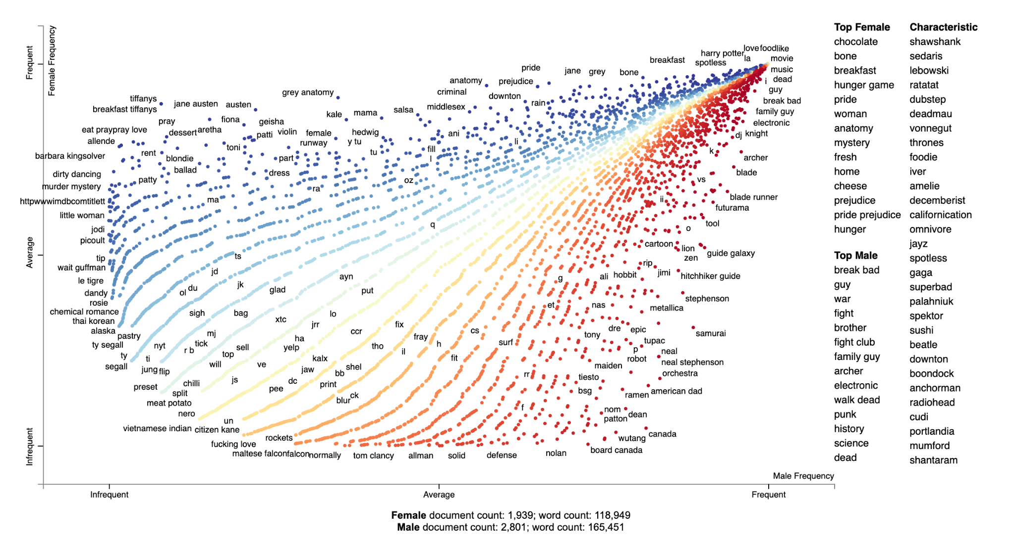
What women & men love to listen/read/watch to:

Slide 27
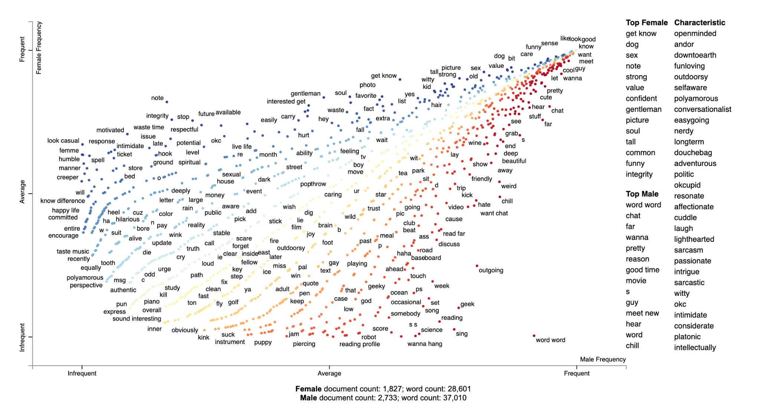
What women & men are looking for:

Slide 28
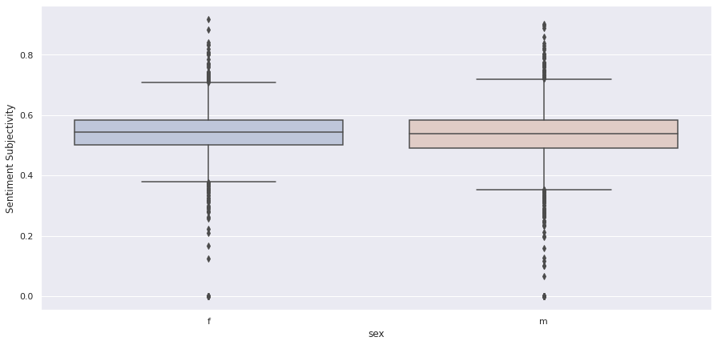
Sentiment Subjectivity using TextBlob
Notes:
Sentiment Subjectivity computed by sex.
Shows females tend to be a little more personal in their writings, but not in a distinctive difference.
Semantic similarity can play a big role in text processing like for intent classification.
TextBlob is a python library for NLP which uses the NLTK package to access its lexical resources.
For lexicon-based approaches, a sentiment is defined by its semantic orientation and the intensity of each word in the sentence.
This requires a pre-defined dictionary classifying negative and positive words.
After assigning individual scores to all the words, final sentiment is calculated.
TextBlob returns polarity and subjectivity of a sentence.
Subjectivity lies between [0,1].
Subjectivity quantifies the amount of personal opinion and factual information contained in the text.
The higher subjectivity means that the text contains personal opinion rather than factual information.

Slide 29
Word Embedding / Similarity
The similarity function in spaCy is by default calculated as cosine similarity, with vectors averaged over the document for missing words.
We implemented a matcher function to find the matching score between a user and 4 potential matches according to their preferences.
Notes:
0 - 1 score.
Similarity is determined by comparing word vectors or “word embeddings”, multi-dimensional meaning representations of a word.
Word vectors can be generated using an algorithm like word2vec
By default it's cosine similarity, with vectors averaged over the document for missing words.
We tried to implement a function to find best matches for a user according to his/her preferences and sex.

Slide 30

Next Project - Hack the App using ML…
💖💖💖 Thank you

Slide 31


